Slide 1
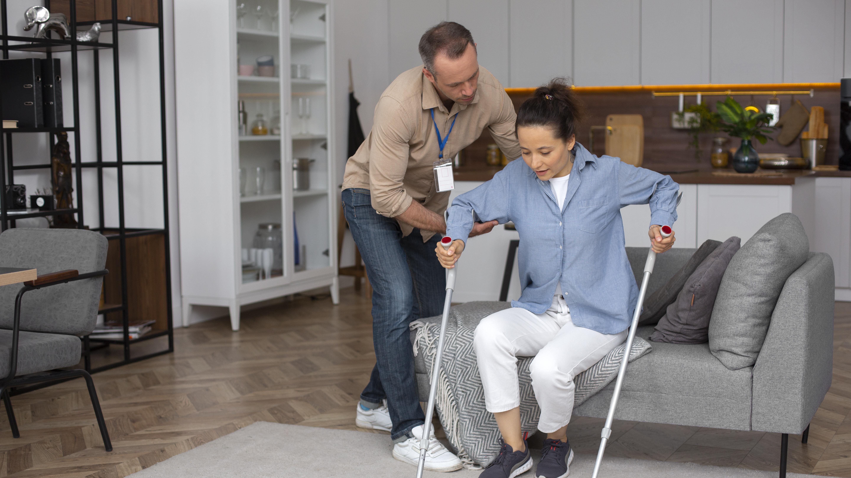
Facilitate Choice And Self-Determination
CHCCCS038 - Facilitate the empowerment of people receiving support (Release 1)

Slide 2


Motivation is an essential aspect of the well-being of a person receiving support.
It allows a person to engage in activities and become receptive to strategies designed to assist their care.
Motivation can be classified into two:
Internal Motivation
Refers to the satisfaction of applying oneself is enough to encourage a person to accomplish their goals
Determined by the values and goals of the person
Facilitate Choice And Self-Determination

Slide 3
Motivation can be classified into two:
External Motivation
Refers to external rewards such as praise and approval are used as motivators
Determined by the values and goals of others (e.g., family, friends, carers)
Facilitate Choice And Self-Determination

Slide 4
One of the key factors that can affect a person's motivation is the theory of self-determination.
Self-determination refers to a person's ability to make their own choices, actions and decisions.
It involves providing specific needs to allow a person freedom.
This feeling of freedom, in turn, enhances a person's internal motivation.
Facilitate Choice And Self-Determination

Slide 5

You must address the following needs to allow a person to develop a greater sense of self-determination:
Competence refers to a person's need to feel that they have sufficient skills and intellect.
Relatedness refers to a person's need to feel a sense of attachment, closeness and belonging to a social group.
Autonomy refers to a person's need to feel that they control their own choices and decisions.
Facilitate Choice And Self-Determination

Slide 6

Self-determination is vital to empowering a person receiving support.
Care workers must make sure that the person is internally motivated to improve their own conditions.
Failure to motivate the person can lead to situations where any effort to empower them does not create any meaningful change in their life.
Facilitate Choice And Self-Determination

Slide 7
Self-determination is also closely tied to human rights allowing a client to make their own choices and decisions that contributes towards the fulfilment of the following rights:
All peoples have the right of self determination.
Persons with disability have the inherent right to respect for their human dignity.
Persons with disability are entitled to the measures designed to enable them to become as self-reliant as possible.
Facilitate Choice And Self-Determination

Slide 8
In general, people receiving support who are self-determined have a better quality of life than others.
This is because self-determined people are:
Less prone to abuse
Less dependent on others
Capable of making choices that benefit their health
Capable of doing well at school or landing better jobs
More likely to seek assistance and want to help others
Facilitate Choice And Self-Determination

Slide 9
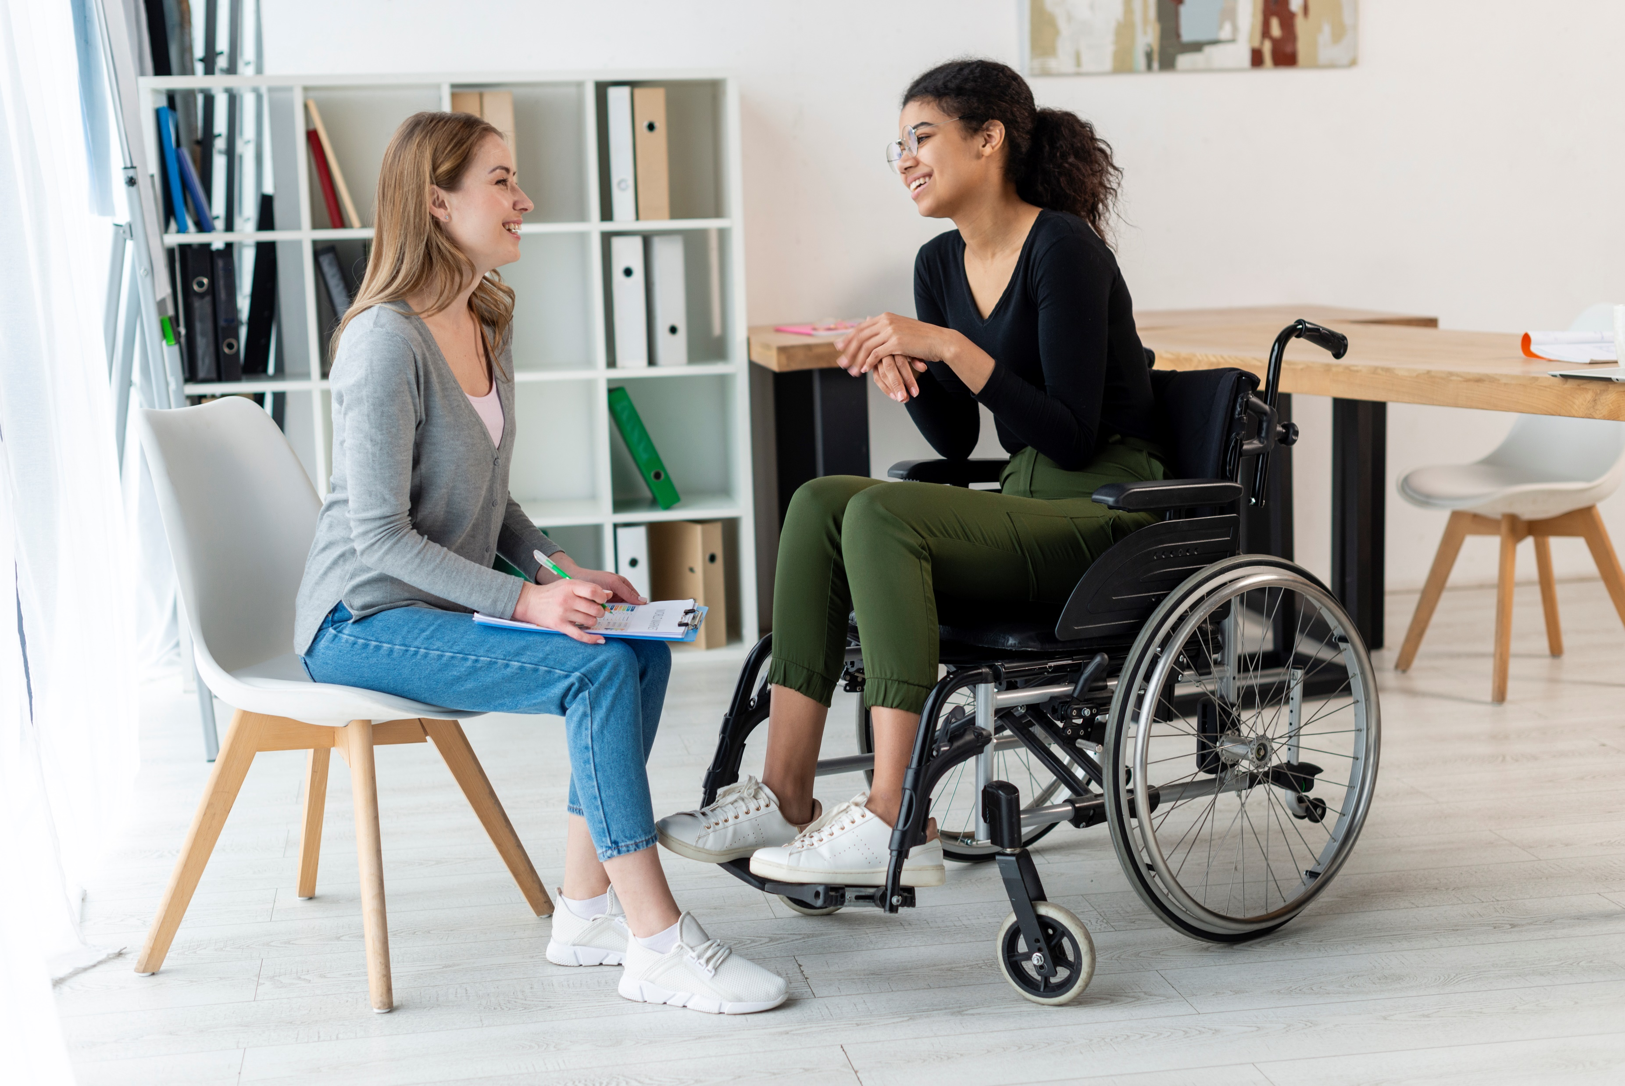
3.1 Use A Person-Centred Approach to Acknowledge the Person as Their Own Expert

Slide 10
A person-centred approach only works if it truly puts the person in the centre of all decisions making the person both the recipient and source of care strategies.
These strategies include procedures for empowerment and appropriate care.
There is a tendency that care workers and other carers do not consider the opinions of the client.
This should not be the case.
Facilitate Choice And Self-Determination

Slide 11
Clients are more capable of stating what they need and what services they would like to receive due to the following reasons:
They know and understand their own experiences better than anyone.
They may have feelings or emotions that others may not understand.
They may have desires or preferences that might not make sense to others.
They can speak on a personal basis and thus may provide more detailed or specific information on what they need help with.
Facilitate Choice And Self-Determination

Slide 12
Acknowledging the client as their own expert provides the following benefits:
It frames the client as capable of making active decisions rather than needing help all the time.
It gives the client an active role in shaping their life.
It motivates others to share their experiences and talk about what they are currently enjoying or struggling with.
Facilitate Choice And Self-Determination

Slide 13
You can improve the service you provide to a client by using person-centred approach through treating them as their own expert involving the following practices:
Asking how the client feels about specific actions or decisions instead of directly endorsing one
Answering the client’s questions honestly
Helping the client to explain their choices and decisions through supportive questions
Facilitate Choice And Self-Determination

Slide 14
You can improve the service you provide to a client by using person-centred approach through treating them as their own expert involving the following practices:
Listening attentively and verifying if you understood the client
Respecting the client’s decisions and using care strategies that are aligned with the client’s wishes
Facilitate Choice And Self-Determination

Slide 15

Strengths-Based Approaches
A care worker using a strengths-based approach can restore a person’s confidence, building upon a person’s strengths.
Knowing their strengths allows them to see themself at their best.
Facilitate Choice And Self-Determination

Slide 16
Strengths-based approach gives an idea of what changes can improve the quality of the life of person under your care having the following principles:
The person has individual aspects that help them grow.
The person has a responsibility to maintain and improve their wellbeing.
The person has the willingness to learn, improve and change.
Facilitate Choice And Self-Determination

Slide 17
When using strength-based approaches, a care worker must:
Assess the strengths and capabilities of the person and use them in planning care strategies
Maximise the use of resources available to the person to improve their condition
Induce hope in the person by affirming their improvement and showing an appreciation for their capability
Allow the person to choose what they want to do or how they want to work on their problems
Facilitate Choice And Self-Determination

Slide 18
Remember that, using the strength-based approaches is vital in individualised support.
The strengths-based approaches:
Enable the person to see themselves at their best and see their own value:
They can move that value forward and utilise their strengths instead of focusing on their illnesses, disability or conditions.
Help in identifying constraints or limitations present in the person’s environment and look for ways in addressing or removing these constraints or limitations to enable the person to achieve their goals
Facilitate Choice And Self-Determination

Slide 19
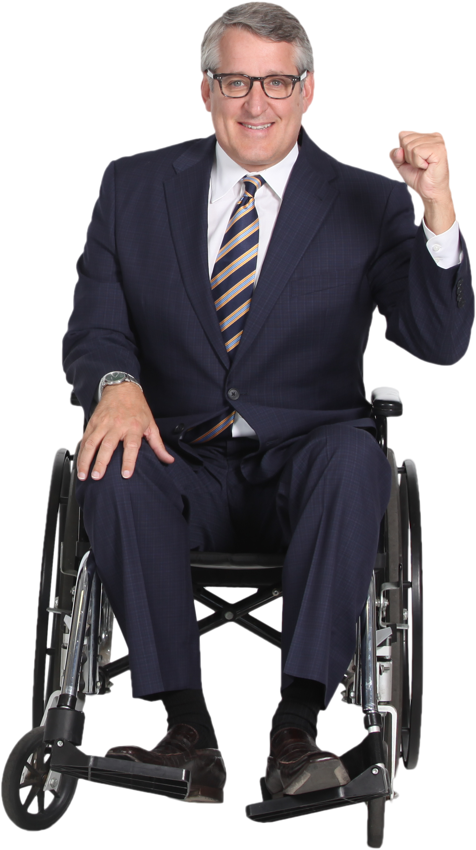
Self-Advocacy
Self-advocacy simply means allowing and assisting a person in speaking up for themselves.
As a care worker, you must help the client access the various self-advocacy groups available to them.
Facilitate Choice And Self-Determination

Slide 20
Throughout Australia, many self-advocacy groups have been formed so that people can share practices and information.
This support allows a client to:
Speak up for themself
Fight for their rights
Work together with other people to make change happen
Self-advocacy groups offer a wide range of activities and programs.
Facilitate Choice And Self-Determination

Slide 21
As a care worker, you may need to assist the people under your care in taking part in various activities.
The following are examples of such activities:
Participating in sharing sessions where members can talk about their life experiences
Reflecting and meditating on experiences and writing down insights
Attending educational sessions for self-growth, such as forming intimate relationships
Raising community awareness by running training programs and events to discuss various issues
Facilitate Choice And Self-Determination

Slide 22
The following are examples of such activities:
Responding to queries by government agencies and other groups
Conducting their own research and creating instructional materials such as videos and infographics
Participating in other activities that are interesting and fulfilling to the client
Representing clients and their families on advisory committees and other outlets
Lobbying or campaigning about specific issues
Facilitate Choice And Self-Determination

Slide 23

3.2 Assist the Person and Their Support System in Options for Action on Relevant Issues

Slide 24
Assisting a client in their decision making allows you to provide a service that is:
Empowering
Person-centred
Doing so can be challenging, as a person may have difficulty making their own decisions in some cases due to challenges in processing and understanding information.
Facilitate Choice And Self-Determination

Slide 25
These challenges are common in cases where a client suffering from brain injuries or other cognitive disorders making them incapable of decision-making.
These options provide different actions on relevant issues, such as:
Medical issues
Legal issues
Financial issues
Other life matters that require urgent or informed decisions
Facilitate Choice And Self-Determination

Slide 26
Supported decision-making is ‘the provision of support which enables persons with cognitive disability to exercise their legal decision-making rights (also called legal capacity)’.
It involves the appointment of supporters, who are responsible of:
Helping the person in making decisions
Assisting the client in weighing different options affecting the support services the client receive and other important matters
Facilitate Choice And Self-Determination

Slide 27

Supporters can be:
Family members
Close friends
Primary caregivers
Partners or significant others
Relevant others (e.g. any person that the person trusts to assist them in making correct decisions)
Facilitate Choice And Self-Determination

Slide 28
Supporters can take on specific, legally recognised roles.
These roles are based on federal and state or territory legislation.
Therefore, supporter roles may vary depending on your state or territory.
Facilitate Choice And Self-Determination

Slide 29

Below are recognised roles of supporters in Victoria:
Supportive attorney (based on Powers of Attorney Act) – A client appoints a supportive attorney to support them to make and act on their decisions except for financial transaction like property selling.
Supportive guardian and supportive administrator (based in Guardianship and Administration Act) – Supporting a client to make their own decisions.
Foster Human Rights

Slide 30
Below are recognised roles of supporters in Victoria:
Support person - medical (based on Medical Treatment Planning and Decisions Act) – A client can appoint another person as their medical support person to help make, communicate and act on their medical treatment decisions.
Plan nominee (based on National Disability Insurance Scheme [NDIS] Act) – A plan nominee is someone appointed to act on behalf of an NDIS participant.
Facilitate Choice And Self-Determination

Slide 31

Below are recognised roles of supporters in Victoria:
Nominated person (based on the Mental Health Act) – A client chooses a nominated person to represent and support them if they become a patient under the Mental Health Act.
Facilitate Choice And Self-Determination

Slide 32

As a facilitator, you must:
Assist the person to exercise their right to be involved in planning their own care and support with those providing it
Support their independent action and thinking
Foster Human Rights

Slide 33
To assist and support your client, consider doing the following strategies:
Give the client and their supporters enough space and time to discuss their options and make their decisions.
Take note of all decisions that the client makes.
Be aware of every supporter’s role.
Look out for possible instances of abuse or conflicts of interest.
Remember that the client themself is experiencing changes.
Remember your original goal of empowerment and self-determination.
Facilitate Choice And Self-Determination

Slide 34

3.3 Assist the Person in Communicating Their Personal Goals

Slide 35
A self-determined and motivated person will be much easier to care for.
As a care worker, you must assist your clients in clearly communicating their personal goals with you and others involved in their individualised plan to ensure that the client will have the necessary support they need to achieve their goals.
Facilitate Choice And Self-Determination

Slide 36
To assist the client to communicate their personal goals with you and those involved in their individualised plan, you may consider doing the following:
Ask for your clients’ consent.
Discuss all essential details with your clients.
Respect your clients’ wishes.
Follow the procedures on privacy, confidentiality and disclosure.
Make sure to prevent others from forcing your clients to share their information.
Facilitate Choice And Self-Determination

Slide 37

As you assist the person in communicating their personal goals, make sure to adhere to the principles of active support. Doing so will allow you to:
Understand the person better and make it easier for them to state their ideas
Show the person that you are committed to assisting them and that you care about their goals.
Facilitate Choice And Self-Determination

Slide 38
Active Support
Active support means providing the appropriate amount of support to the client.
The method encourages the client to do things for themself, when possible, rather than having someone else do it on their behalf.
Facilitate Choice And Self-Determination

Slide 39
As a care worker, you must show that you will use the information on a client’s personal goals for active support.
To do this, you will have to abide by the following principles:
Belongingness refers to supporting the client to be part of the community to supporting them to have positive relationships with others.
Opportunity refers to supporting the client to have novel experiences to supporting them to have many avenues of self-directed learning.
Facilitate Choice And Self-Determination

Slide 40
To do this, you will have to abide by the following principles:
Respect refers to supporting the client that recognises and upholds their individuality.
Self-control refers to supporting the client that recognises and upholds their capability to regulating their actions, emotions and behaviour.
Facilitate Choice And Self-Determination

Slide 41
Adherence to these principles involve the following:
By adhering to these principles, you can assist the person so that only the necessary assistance is given.
Helping the client without affecting their relationship with others
Determining what assistance is needed
Maximising choice and control
Refraining from withholding information from the client
Facilitate Choice And Self-Determination

Slide 42
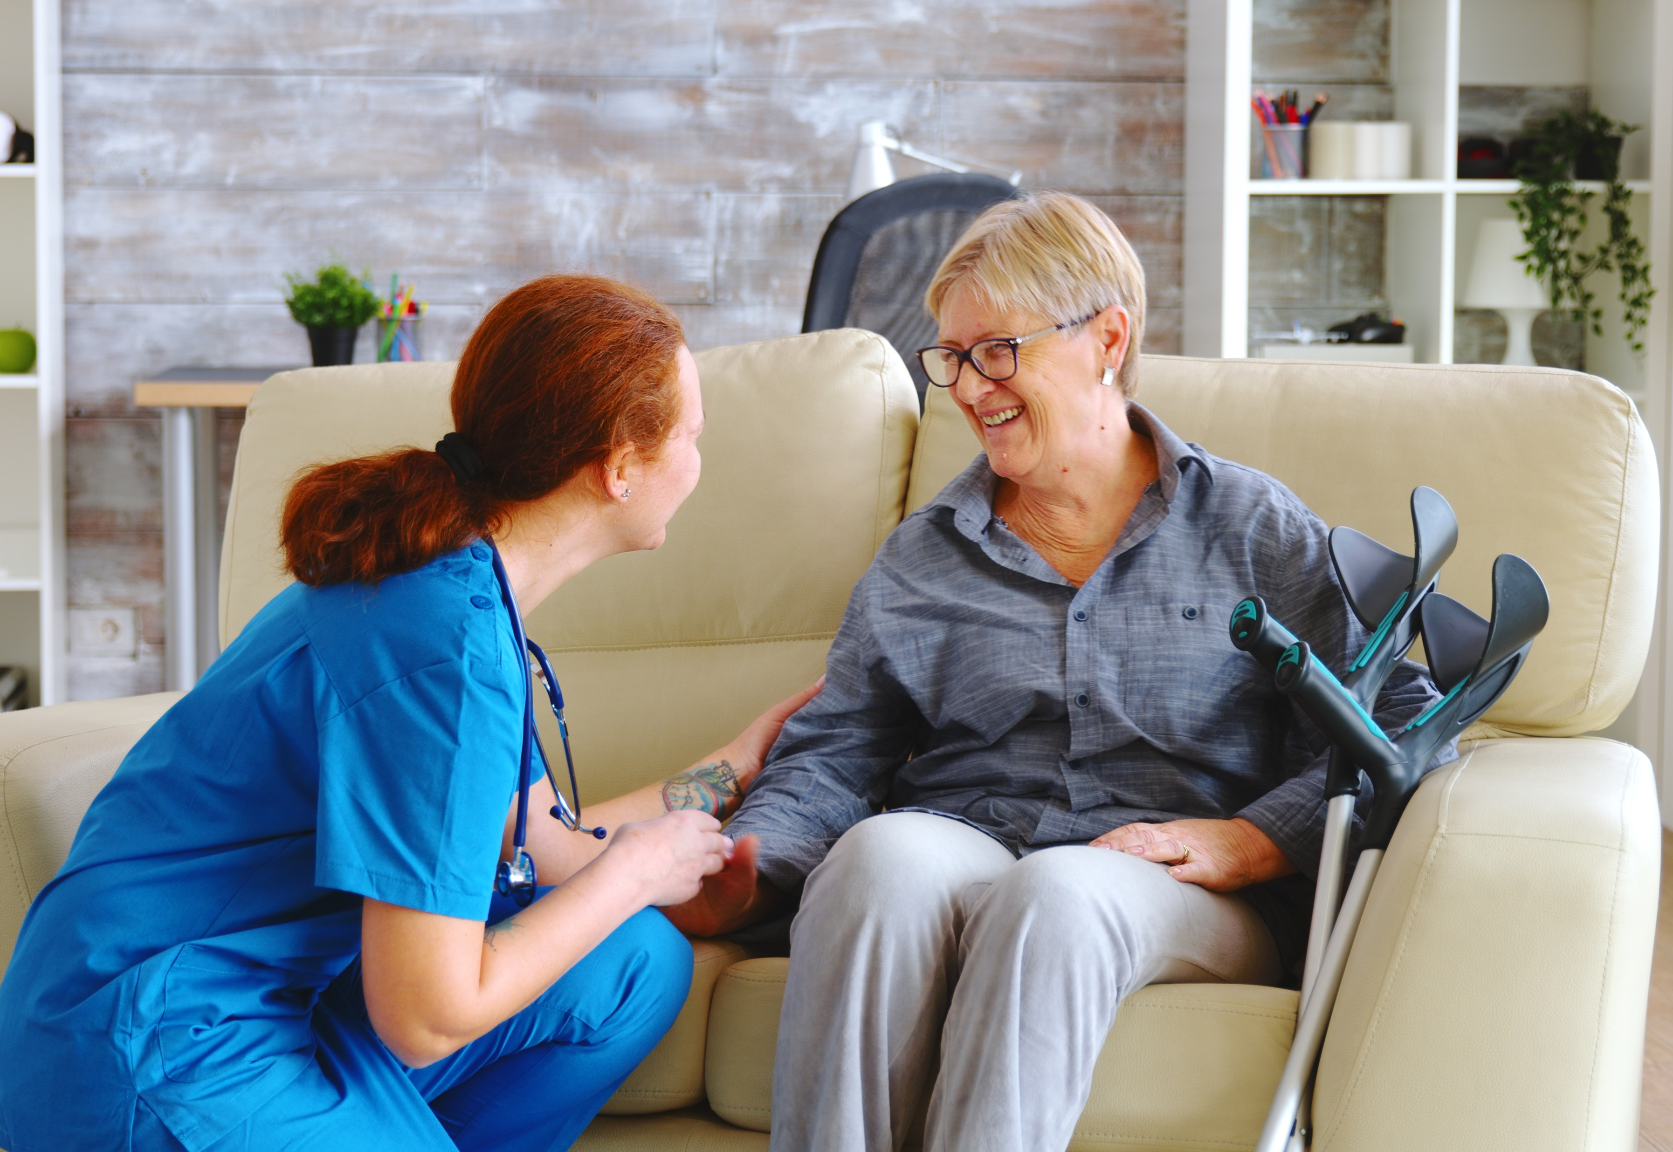
3.4 Provide Support That Encourages the Person to Make Their Own Choices

Slide 43
Person-centred support allows a person to live their life in a way that is most comfortable to them.
A form of support that provides empowerment in the form of independence and autonomy.
You must use person-centred support to help your clients to make decisions and choices for themselves.
Facilitate Choice And Self-Determination

Slide 44
Encouraging a client to make their own choices involves doing the following:
Give the client all essential options and information on strategies to meet their individual or reablement needs
Use appropriate communication techniques to guide the client in making a choice
Give the client time to think about their choice
Assist the client in searching for additional information regarding the choices
Remind the client of the goals they set for themselves
Facilitate Choice And Self-Determination

Slide 45

Encouraging a client to make their own choices involves doing the following:
Assure the client that their choices and decisions are important and that it is alright to make mistakes now and then.
Remind the client that they can assign supporters to help them in making choices and decisions.
Facilitate Choice And Self-Determination

Slide 46
Of course, there is a danger to letting the client make choices for themselves.
Often, a client who has many options to choose from will:
Take a long time making a choice, which, in turn, causes them to be stuck or unable to move forward
Feel unsatisfied or wanting after making a choice due to the possibility that one of the other choices could be better
Make the wrong choice more often, as having more options also means having more chances to make a mistake.
Facilitate Choice And Self-Determination

Slide 47
In order for your client not to fall victim to those dangers, you must empower them by doing the following:
Reduce the need for the client to go through many options by using close ended questions instead of open-ended questions.
Use appropriate modelling techniques to guide the client towards making responsible choices.
Facilitate Choice And Self-Determination

Slide 48
In order for your client not to fall victim to those dangers, you must empower them by doing the following:
Help the client develop a personal method for making choices that should help:
Build familiarity with the different options available
Find and analyse the benefits and consequences for choosing each option
Consider their personal goals, values and beliefs in a step-by-step manner
Know the legal implications of their choices and avoid illegal options
Feel assured and confident in their choice
Facilitate Choice And Self-Determination

Slide 49

In order for your client not to fall victim to those dangers, you must empower them by doing the following:
Come up with a way for the client to communicate their choice.
Provide opportunities to make choices every day.
Facilitate Choice And Self-Determination

Slide 50
Informed Consent
Informed consent refers to a person granting permission for others to any information that can be used to identify them.
Permission is informed if the person is given all essential details on the decision being made, including:
Possible outcomes of the decision
Risks involved with the decision
Effects that the decision may have on their financial assets
Facilitate Choice And Self-Determination

Slide 51
Informed consent is necessary in all cases, except when:
A court order requires you to provide information without the consent of the client
Giving information is needed to assist law enforcement agencies and other government agencies
There is reason to believe that the client is in danger or risk of harm, and the information is needed to file a report
Facilitate Choice And Self-Determination

Slide 52
When ensuring that the client can provide informed consent, it will be necessary to:
Respect the client's wishes
Follow the procedures on privacy, confidentiality and disclosure
Discuss all essential details with the client and answer all questions
Identify if an option will present a substantial risk for harm to the client
Prevent others from forcing the client into making a decision they disagree with
Facilitate Choice And Self-Determination

Slide 53

When ensuring that the client can provide informed consent, it will be necessary to:
Remind the client that they must provide specific information when consenting, such as times for when the consent applies
Remind the client that they also can withdraw consent when necessary.
Facilitate Choice And Self-Determination

Slide 54
Clients may not be able to provide informed consent using conventional means which is true for a client with impairments affecting their ability to communicate verbally and non-verbally.
As such, the client may need to be assisted.
When assisting the client in decision making, it will be essential to develop appropriate strategies based on what they can do.
Facilitate Choice And Self-Determination

Slide 55
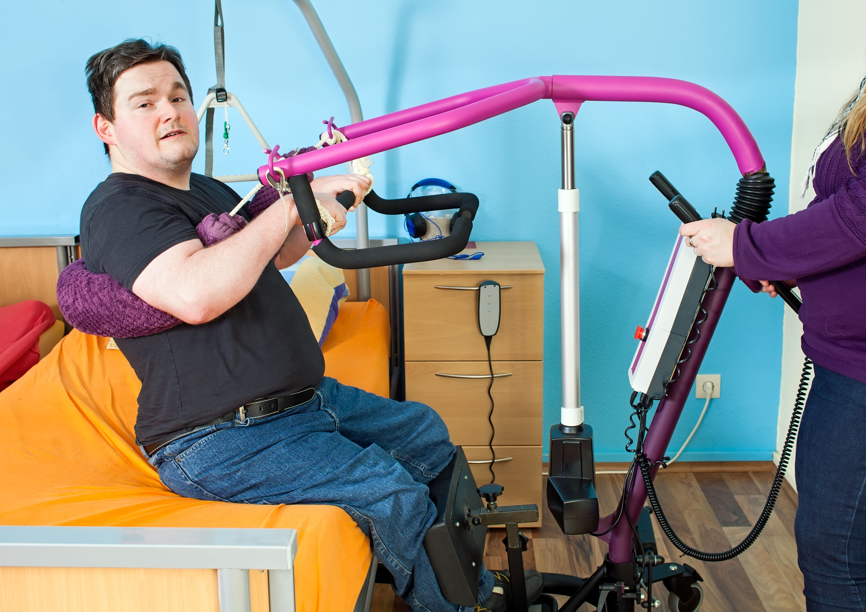
3.5 Assist the Person in Using Assistive Technologies

Slide 56
Assistive technology refers to the devices and equipment designed to support persons with disability to help them live their independent lives.
Using assistive technology can do the following:
Positively impact the health and wellbeing of the person
Promote the independence of the person
Maintain the independence of the person
Facilitate Choice And Self-Determination

Slide 57
Using assistive technology can do the following:
Enable the person to be included in various activities available for all people.
Allows the person to participate in their community fully.
Ease the process for making choices and decisions for the person.
Facilitate Choice And Self-Determination

Slide 58
3.5.1 Scope and Breadth of Assistive Technology
Scope refers to the activities where a person can use assistive technology.
Breadth refers to the range of devices and technologies used explicitly for an activity.
As a care worker, you must understand the scope and breadth of assistive technologies to help you identify what devices or equipment a person needs.
Assistive technology is beneficial and useful to your clients mainly on the following:
Communication
Daily Living Activities
Facilitate Choice And Self-Determination

Slide 59

Communication
One of the common individual needs of a person is the need to communicate and interact with others.
A person may use assistive devices to communicate aside from non-verbal communication.
Facilitate Choice And Self-Determination

Slide 60
The following tables list down the breadth of assistive technology used for communication according to a person’s impairment:
Impairment | Breadth of Assistive Technology
Hearing | FM systems are wireless devices use radio signals to connect a microphone to hearing aids or receivers. Closed-captioning software converts speech and sounds into text for persons with hearing impairment to follow along the program.
Facilitate Choice And Self-Determination

Slide 61
The following tables list down the breadth of assistive technology used for communication according to a person’s impairment:
Impairment | Breadth of Assistive Technology
Hearing | Hearing aids help people with hearing difficulty regain some level of hearing.
Speech | Communicators are devices used for communication. These devices can range from a simple notepad to electronic communication boards and keyboards.
Facilitate Choice And Self-Determination

Slide 62
The following tables list down the breadth of assistive technology used for communication according to a person’s impairment:
Impairment | Breadth of Assistive Technology
Speech | Eye gaze is an electronic device that allows the person to communicate by looking at words or commands on a screen. Text-to-speech software (TTS) allows the person to type out what they want to say and the device can read it aloud to others to hear.
Facilitate Choice And Self-Determination

Slide 63
The following tables list down the breadth of assistive technology used for communication according to a person’s impairment:
Impairment | Breadth of Assistive Technology
Vision | Alternative print materials are books, manuals and handouts are printed in: High contrast text for a client with partial vision loss Braille for a client with complete vision loss.
Facilitate Choice And Self-Determination

Slide 64
The following tables list down the breadth of assistive technology used for communication according to a person’s impairment:
Impairment | Breadth of Assistive Technology
Vision | Pocket magnifiers are portable lenses to make texts and objects appear larger. Audiobooks are recordings of print materials being read out loud. Reading gadgets convert the text of printed materials that are usually unavailable in audio, braille or enlarged print form into speech.
Facilitate Choice And Self-Determination

Slide 65
The following tables list down the breadth of assistive technology used for communication according to a person’s impairment:
Impairment | Breadth of Assistive Technology
Vision | Text-to-speech (TTS) is a feature in modern phones and computers that can read text on screen aloud. Visual support software can enlarge text and increase the contrast of screens to make the content easier to read.
Facilitate Choice And Self-Determination

Slide 66
The following tables list down the breadth of assistive technology used for communication according to a person’s impairment:
Impairment | Breadth of Assistive Technology
Vision | Refreshable braille displays process information on computer screens and electronically raises and lowers different combinations of pins in braille cells. Text continuously changes as the person moves the cursor around the screen.
Facilitate Choice And Self-Determination

Slide 67
The following tables list down the breadth of assistive technology used for communication according to a person’s impairment:
Impairment | Breadth of Assistive Technology
Cognition and Memory Loss | Sensory regulators allow the person to cope with lowered or heightened senses. Noise-cancelling headphones reduce distracting background noises to prevent overstimulation.
Facilitate Choice And Self-Determination

Slide 68
The following tables list down the breadth of assistive technology used for communication according to a person’s impairment:
Impairment | Breadth of Assistive Technology
Cognition and Memory Loss | Memory/cueing aids help the person recall information. Word prediction software is a kind of software that aids the person with writing and spelling difficulties by recalling required words that can improve their grammar and sentence structure.
Facilitate Choice And Self-Determination

Slide 69

Daily Living Activities
These refer to the self-care activities people do every day to keep themselves safe, healthy and feeling good.
These activities are usually done in the home and independently by the person.
Facilitate Choice And Self-Determination

Slide 70
There are two kinds of activities for daily living:
Activities of Daily Living (ADL) - These include the following self-care tasks at home:
Continence (e.g. using the toilet)
Hygiene (e.g. bathing, brushing and styling hair, shaving, dressing)
Mobility and transferring (e.g. walking, getting in and out of bed)
Eating and drinking
Pressure area management
Carer support (i.e. alerting carers if there is a problem)
Facilitate Choice And Self-Determination

Slide 71
There are two kinds of activities for daily living:
Instrumental Activities of Daily Living (IADL) - These refer to activities for maintaining an independent life in other environments, such as:
Recreation and leisure
Education and employment
Facilitate Choice And Self-Determination

Slide 72
The following tables list down the breadth of assistive technology used for the kinds of activities for daily living.
ADL/IADL | Breadth of Assistive Technology
Continence | Bedpans are receptacles used for a patient who is bedridden in a health care facility. They can be used for both urinary and faecal discharge. Bedside commodes provide a safer alternative for people who are at risk of falling or slipping in the bathroom.
Facilitate Choice And Self-Determination

Slide 73
The following tables list down the breadth of assistive technology used for the kinds of activities for daily living.
ADL/IADL | Breadth of Assistive Technology
Continence | Bed and chair pads are absorbent pads placed discreetly on top of a chair or bed. They can be either disposable or washable. Toilet seat raisers increases the height of the toilet pan, which makes it easier for a person to sit down on and stand up from the toilet.
Facilitate Choice And Self-Determination

Slide 74
The following tables list down the breadth of assistive technology used for the kinds of activities for daily living.
ADL/IADL | Breadth of Assistive Technology
Continence | Urine drainage bags collect urine by attaching the bag to a catheter tube inside a person's bladder.
Self-care and hygiene | Grab bars are bars installed in a shower or next to a bathtub. This supports a person when going in and out of the shower or bathtub.
Facilitate Choice And Self-Determination

Slide 75
The following tables list down the breadth of assistive technology used for the kinds of activities for daily living.
ADL/IADL | Breadth of Assistive Technology
Self-Care and Hygiene | Shower chair or bench provide support to people with balance issues and help prevent falling. Anti-Slip Mats help make wet surfaces less slippery to prevent falls. Dressing Aids are low-tech devices to help a person in dressing. Examples include shoehorns, stocking aids and button hooks.
Facilitate Choice And Self-Determination

Slide 76
The following tables list down the breadth of assistive technology used for the kinds of activities for daily living.
ADL/IADL | Breadth of Assistive Technology
Mobility | Walking sticks, walkers, crutches and canes are devices designed to support a person’s balance while standing or walking. These devices take away some pressure off of one or both legs. Wheelchairs provide wheeled movement and seating support.
Facilitate Choice And Self-Determination

Slide 77
The following tables list down the breadth of assistive technology used for the kinds of activities for daily living.
ADL/IADL | Breadth of Assistive Technology
Mobility | Prosthetic devices are devices that imitate the human body’s movements depending on the device’s complexity. Walking helps the person navigate their way in the park. Reachers help the person reach items without bending over or raising their arms.
Facilitate Choice And Self-Determination

Slide 78
The following tables list down the breadth of assistive technology used for the kinds of activities for daily living.
ADL/IADL | Breadth of Assistive Technology
Mobility | Prosthetic devices are devices that imitate the human body’s movements depending on the device’s complexity.
Transferring | Slide sheets allow easy repositioning on the bed with less friction.
Facilitate Choice And Self-Determination

Slide 79
The following tables list down the breadth of assistive technology used for the kinds of activities for daily living.
ADL/IADL | Breadth of Assistive Technology
Transferring | Transfer belts are used for easy transferring and assisted walking. Transfer boards are full body-length boards used to transfer a person from one surface to another. Sling are fabric supports used to carry a person.
Facilitate Choice And Self-Determination

Slide 80
The following tables list down the breadth of assistive technology used for the kinds of activities for daily living.
ADL/IADL | Breadth of Assistive Technology
Transferring | Stretchers are rigid frames used to carry a person in a lying position. Stretchers are used to often transfer people to different locations. Hoists have three kinds: mobile, standing and ceiling. Mobile and ceiling hoists are used to lift a person inside a sling or stretcher. Standing hoists are used to assist a person in sitting or standing.
Facilitate Choice And Self-Determination

Slide 81
The following tables list down the breadth of assistive technology used for the kinds of activities for daily living.
ADL/IADL | Breadth of Assistive Technology
Eating and Drinking | Adaptive dinnerware are plates and bowls are designed to ensure that food will not slide around and fall out. Dinnerware can also be modified to not slide around a table with grip bottoms. Assistive utensils are forks, knives and spoons that are adapted to the needs of an individual.
Facilitate Choice And Self-Determination

Slide 82
The following tables list down the breadth of assistive technology used for the kinds of activities for daily living.
ADL/IADL | Breadth of Assistive Technology
Eating and Drinking | Utensil holders are for people who find holding utensils challenging. Utensil holders include straps, clips and foam handles. Foam handles assist a person who can hold utensils but have a problem with their grip.
Facilitate Choice And Self-Determination

Slide 83
The following tables list down the breadth of assistive technology used for the kinds of activities for daily living.
ADL/IADL | Breadth of Assistive Technology
Eating and Drinking | Feeding devices are designed to allow a person who cannot self-feed to eat independently. There are manual and powered feeders that a person may use.
Facilitate Choice And Self-Determination

Slide 84
The following tables list down the breadth of assistive technology used for the kinds of activities for daily living.
ADL/IADL | Breadth of Assistive Technology
Eating and Drinking | Weighted utensils minimise tremors while eating. Non-skid plates prevent the place from moving around while eating. Assistive cups and mugs, like the adaptive dinnerware, can assist a person. The most common assistive drinking utensil is drinking straws.
Facilitate Choice And Self-Determination

Slide 85
The following tables list down the breadth of assistive technology used for the kinds of activities for daily living.
ADL/IADL | Breadth of Assistive Technology
Pressure Area Management | Protectors are devices that help reduce injuries caused by friction. The most common locations for protectors are the elbows and heels of a person. Cushions help lessen the risk of developing pressure ulcers for those who spend long periods in bed or sitting down.
Facilitate Choice And Self-Determination

Slide 86
The following tables list down the breadth of assistive technology used for the kinds of activities for daily living.
ADL/IADL | Breadth of Assistive Technology
Pressure Area Management | Electronic bed frames help change the pressure distribution for a person who is bedridden Offloading footwear is a type of footwear designed to redistribute pressure.
Facilitate Choice And Self-Determination

Slide 87
The following tables list down the breadth of assistive technology used for the kinds of activities for daily living.
ADL/IADL | Breadth of Assistive Technology
Pressure Area Management | Sleep positioners are pillows, rolls and soft rails adjusted to redistribute pressure and keep a person from falling out of bed.
Facilitate Choice And Self-Determination

Slide 88
The following tables list down the breadth of assistive technology used for the kinds of activities for daily living.
ADL/IADL | Breadth of Assistive Technology
Carer Support | Fall detectors alert a carer if the person has taken a fall. Passive infra-red detectors are devices that monitor activity at the home of the person. They can tell a carer whether the person is active, where they are, and if someone has entered the home.
Facilitate Choice And Self-Determination

Slide 89
The following tables list down the breadth of assistive technology used for the kinds of activities for daily living.
ADL/IADL | Breadth of Assistive Technology
Carer Support | Panic buttons are alarm buttons that are used in an event of a break-in or if someone threatening approaches the home of the person. Personal alarms are devices the person can press when they need assistance. These can contact their carer or a response centre.
Facilitate Choice And Self-Determination

Slide 90
The following tables list down the breadth of assistive technology used for the kinds of activities for daily living.
ADL/IADL | Breadth of Assistive Technology
Carer Support | Smart plugs are devices used to monitor the use of household appliances and send an alert to a carer.
Facilitate Choice And Self-Determination

Slide 91
The following tables list down the breadth of assistive technology used for the kinds of activities for daily living.
ADL/IADL | Breadth of Assistive Technology
Recreation and Leisure | Adapted equipment is equipment that has been modified according to the needs of a person. These include sporting equipment, gardening tools, board games and card holders. Magnetic board game pieces prevent the pieces from getting moved around and lost while playing.
Facilitate Choice And Self-Determination

Slide 92
The following tables list down the breadth of assistive technology used for the kinds of activities for daily living.
ADL/IADL | Breadth of Assistive Technology
Recreation and Leisure | All-terrain wheelchairs provide mobility on different surfaces for recreational activities. Self-driving cars allow the person to go from one place to another with less risks associated to driving the car themself.
Facilitate Choice And Self-Determination

Slide 93
The following tables list down the breadth of assistive technology used for the kinds of activities for daily living.
ADL/IADL | Breadth of Assistive Technology
Recreation and Leisure | Switch-adapted equipment is equipment that have been modified where the original switches are rerouted to a switch that is easier to access and operate. These include toys, games and digital cameras.
Education and Employment | Ergonomic furniture is designed to support both function and comfort.
Facilitate Choice And Self-Determination

Slide 94
The following tables list down the breadth of assistive technology used for the kinds of activities for daily living.
ADL/IADL | Breadth of Assistive Technology
Education and Employment | Pen/pencil grips are tools that help improve handwriting, give more control and reduce hand fatigue. Audio recordings are recordings of classes, meetings and print materials read out loud.
Facilitate Choice And Self-Determination

Slide 95
The following tables list down the breadth of assistive technology used for the kinds of activities for daily living.
ADL/IADL | Breadth of Assistive Technology
Education and Employment | Physical Modifications to the environment are modifications that enable access to buildings, such as wider doorways. Ramps help persons who use wheelchairs to move easily through different places.
Facilitate Choice And Self-Determination

Slide 96
3.5.2 Support the Person’s Use of Assistive Technology
As a support worker, you must support the client:
When they are using assistive technology (including assisting them to exercise their right to use technology to facilitate their choice)
In their independent action and thinking
Facilitate Choice And Self-Determination

Slide 97
In supporting the client, you need to take into consideration the following strategies:
Make sure that assistive devices and equipment are available.
Make sure that assistive devices and resources align with the individual needs of the client.
Consider the budget of the client.
Facilitate Choice And Self-Determination

Slide 98
In supporting the client, you need to take into consideration the following strategies:
Consider the client’s learning environment.
Determine if the client needs custom-made equipment.
Ensure that the client understands how to use the assistive technology.
Make sure that equipment is well-maintained.
Facilitate Choice And Self-Determination

Slide 99

3.6 Use Strategies to Make Sure That the Person is Comfortable With Decisions Made

Slide 100
As a care worker, you must ensure that the client is comfortable why any decision being made on their behalf.
It can be challenging to do this, especially if the client needs a guardian or administrator precisely due to difficulties in communicating their decisions effectively.
Below are examples of strategies that you will have to use appropriate to a client’s needs and capabilities:
Say that the client can communicate effectively but cannot make decisions.
Look for changes in routine or behaviour.
Facilitate Choice And Self-Determination

Slide 101
Below are examples of strategies that you will have to use appropriate to a client’s needs and capabilities:
Check for non-verbal cues that the client is not comfortable about the decision made by their guardian or administrator.
Be alert for any signs that the client is being abused or neglected.
Facilitate Choice And Self-Determination

Slide 102

If at any point, you notice that the client is not comfortable with the decisions being made for them, you must:
Help the client to calm down.
Ask the client if they are uncomfortable with a decision made for them.
Based on the client's response, provide appropriate assistance.
Facilitate Choice And Self-Determination

Slide 103
If at any point, you notice that the client is not comfortable with the decisions being made for them, you must:
Explain to the client why certain decisions had to be made.
Go over the duties and responsibilities of the guardian and administrator.
If necessary, assist the client in submitting a complaint to the proper authorities.
Facilitate Choice And Self-Determination

Slide 104

3.7 Identify Barriers to Empowerment and Determine Strategies to Address Them

Slide 105
One of your responsibilities as a care worker is to work with your clients to identify the barriers and obstacles that affect their empowerment.
To do this, you must understand various concepts of barriers and obstacles a person may face.
Facilitate Choice And Self-Determination

Slide 106
3.7.1 Identifying Barriers to Empowerment
The following are common barriers to empowerment that people face:
Attitudinal Barriers – These barriers are the most basic and contribute to other barriers.
Communication Barriers – These are barriers faced by persons with impairment when communicating.
Physical Barriers – These barriers are structural obstacles that can affect one's ability to move freely found in the person’s environment.
Facilitate Choice And Self-Determination

Slide 107
The following are common barriers to empowerment that people face:
Policy Barriers – These barriers are related to laws or policies that discriminate against persons with impairment.
Social Barriers – These barriers are related to the social determinants of a person's health. These determinants include how a person is born, grows, lives, learns, works and ages.
Facilitate Choice And Self-Determination

Slide 108

Here are some strategies you can follow when consulting the client to identify barriers they face:
Review the individualised plan of the client.
See if the client can physically access a service or amenity.
See if the care environment of the client is accessible.
Interview the client.
Interview the family, friends and carer of the client.
Facilitate Choice And Self-Determination

Slide 109
3.7.2 Identifying Obstacles to Empowerment
Aside from these barriers, there are also structural and systemic power and obstacles to their empowerment.
In this context, structural and systemic power stems from the following of a society or organisation:
Interpersonal Relationships and Social Systems
Laws and Regulations
Obstacles, then, refer to the discrimination that stems from structural and systemic power.
Facilitate Choice And Self-Determination

Slide 110
There are several impacts of the structural and systemic obstacles on the empowerment of a person:
Social – These obstacles harm the person's relationships with others.
Physical – These obstacles induce extreme amounts of stress in the person.
Emotional – These obstacles can cause the person to develop self-esteem or mental health issues.
Facilitate Choice And Self-Determination

Slide 111

There are several impacts of the structural and systemic obstacles on the empowerment of a person:
Stigma – This includes negative connotations associated with people with a particular circumstance.
Ageism – This includes the way of thinking about older persons based on negative stereotypes
Facilitate Choice And Self-Determination

Slide 112
There are several impacts of the structural and systemic obstacles on the empowerment of a person:
Cultural – These obstacles impact the well-being of people who are from different cultures.
Economic – These obstacles create fewer opportunities for productivity and employment for the person.
Facilitate Choice And Self-Determination

Slide 113
3.7.3 Determining Strategies to Address Barriers and Obstacles
Once you have identified the barriers and obstacles your clients face, you must determine strategies with them.
Below are some strategies to address the barriers and obstacles to the client's empowerment:
Be supportive.
Establish trust between you and the client.
Recognise and respect the social and ethnic identity of the client.
Encourage the client to interact with others.
Facilitate Choice And Self-Determination

Slide 114
Below are some strategies to address the barriers and obstacles to the client's empowerment:
Educate the community of the client on diversity.
Consider opportunities for education and work for the client.
Facilitate Choice And Self-Determination

Slide 115

3.8 Assist the Person in Accessing Advocacy Services and Other Complaint Mechanisms

Slide 116
Care workers must provide the people they support with ample assistance to their concerns.
This assistance is part of their duty to empowering people and upholding their rights to be seen and heard.
Advocacy services are a form of support for safeguarding the rights of a client.
Facilitate Choice And Self-Determination

Slide 117
Through advocacy services, an advocate can work with a client to:
Help them understand their rights
Represent them in important decision-making processes
Facilitate Choice And Self-Determination

Slide 118
Advocates can also assist the client in:
Identifying and explaining the different options available to the client
Helping the client develop their skills and knowledge for expressing themselves
Assisting the client in standing up for their rights
Speaking with service providers on behalf of the client
Relaying wishes and preferences to other service providers and institutions
Assisting the client in transitioning from one service to another
Resolving concerns or submitting complaints to service providers or authorities
Facilitate Choice And Self-Determination

Slide 119
Persons with disability can access advocacy services.
They can do so under the National Disability Advocacy Program (NDAP).
The NDAP has agencies that uphold and safeguard their rights and freedom to participate.
There are two types of agencies that are available through the NDAP:
Generalist agencies provide advocacy support to persons with any type of disability or cultural background.
Facilitate Choice And Self-Determination

Slide 120
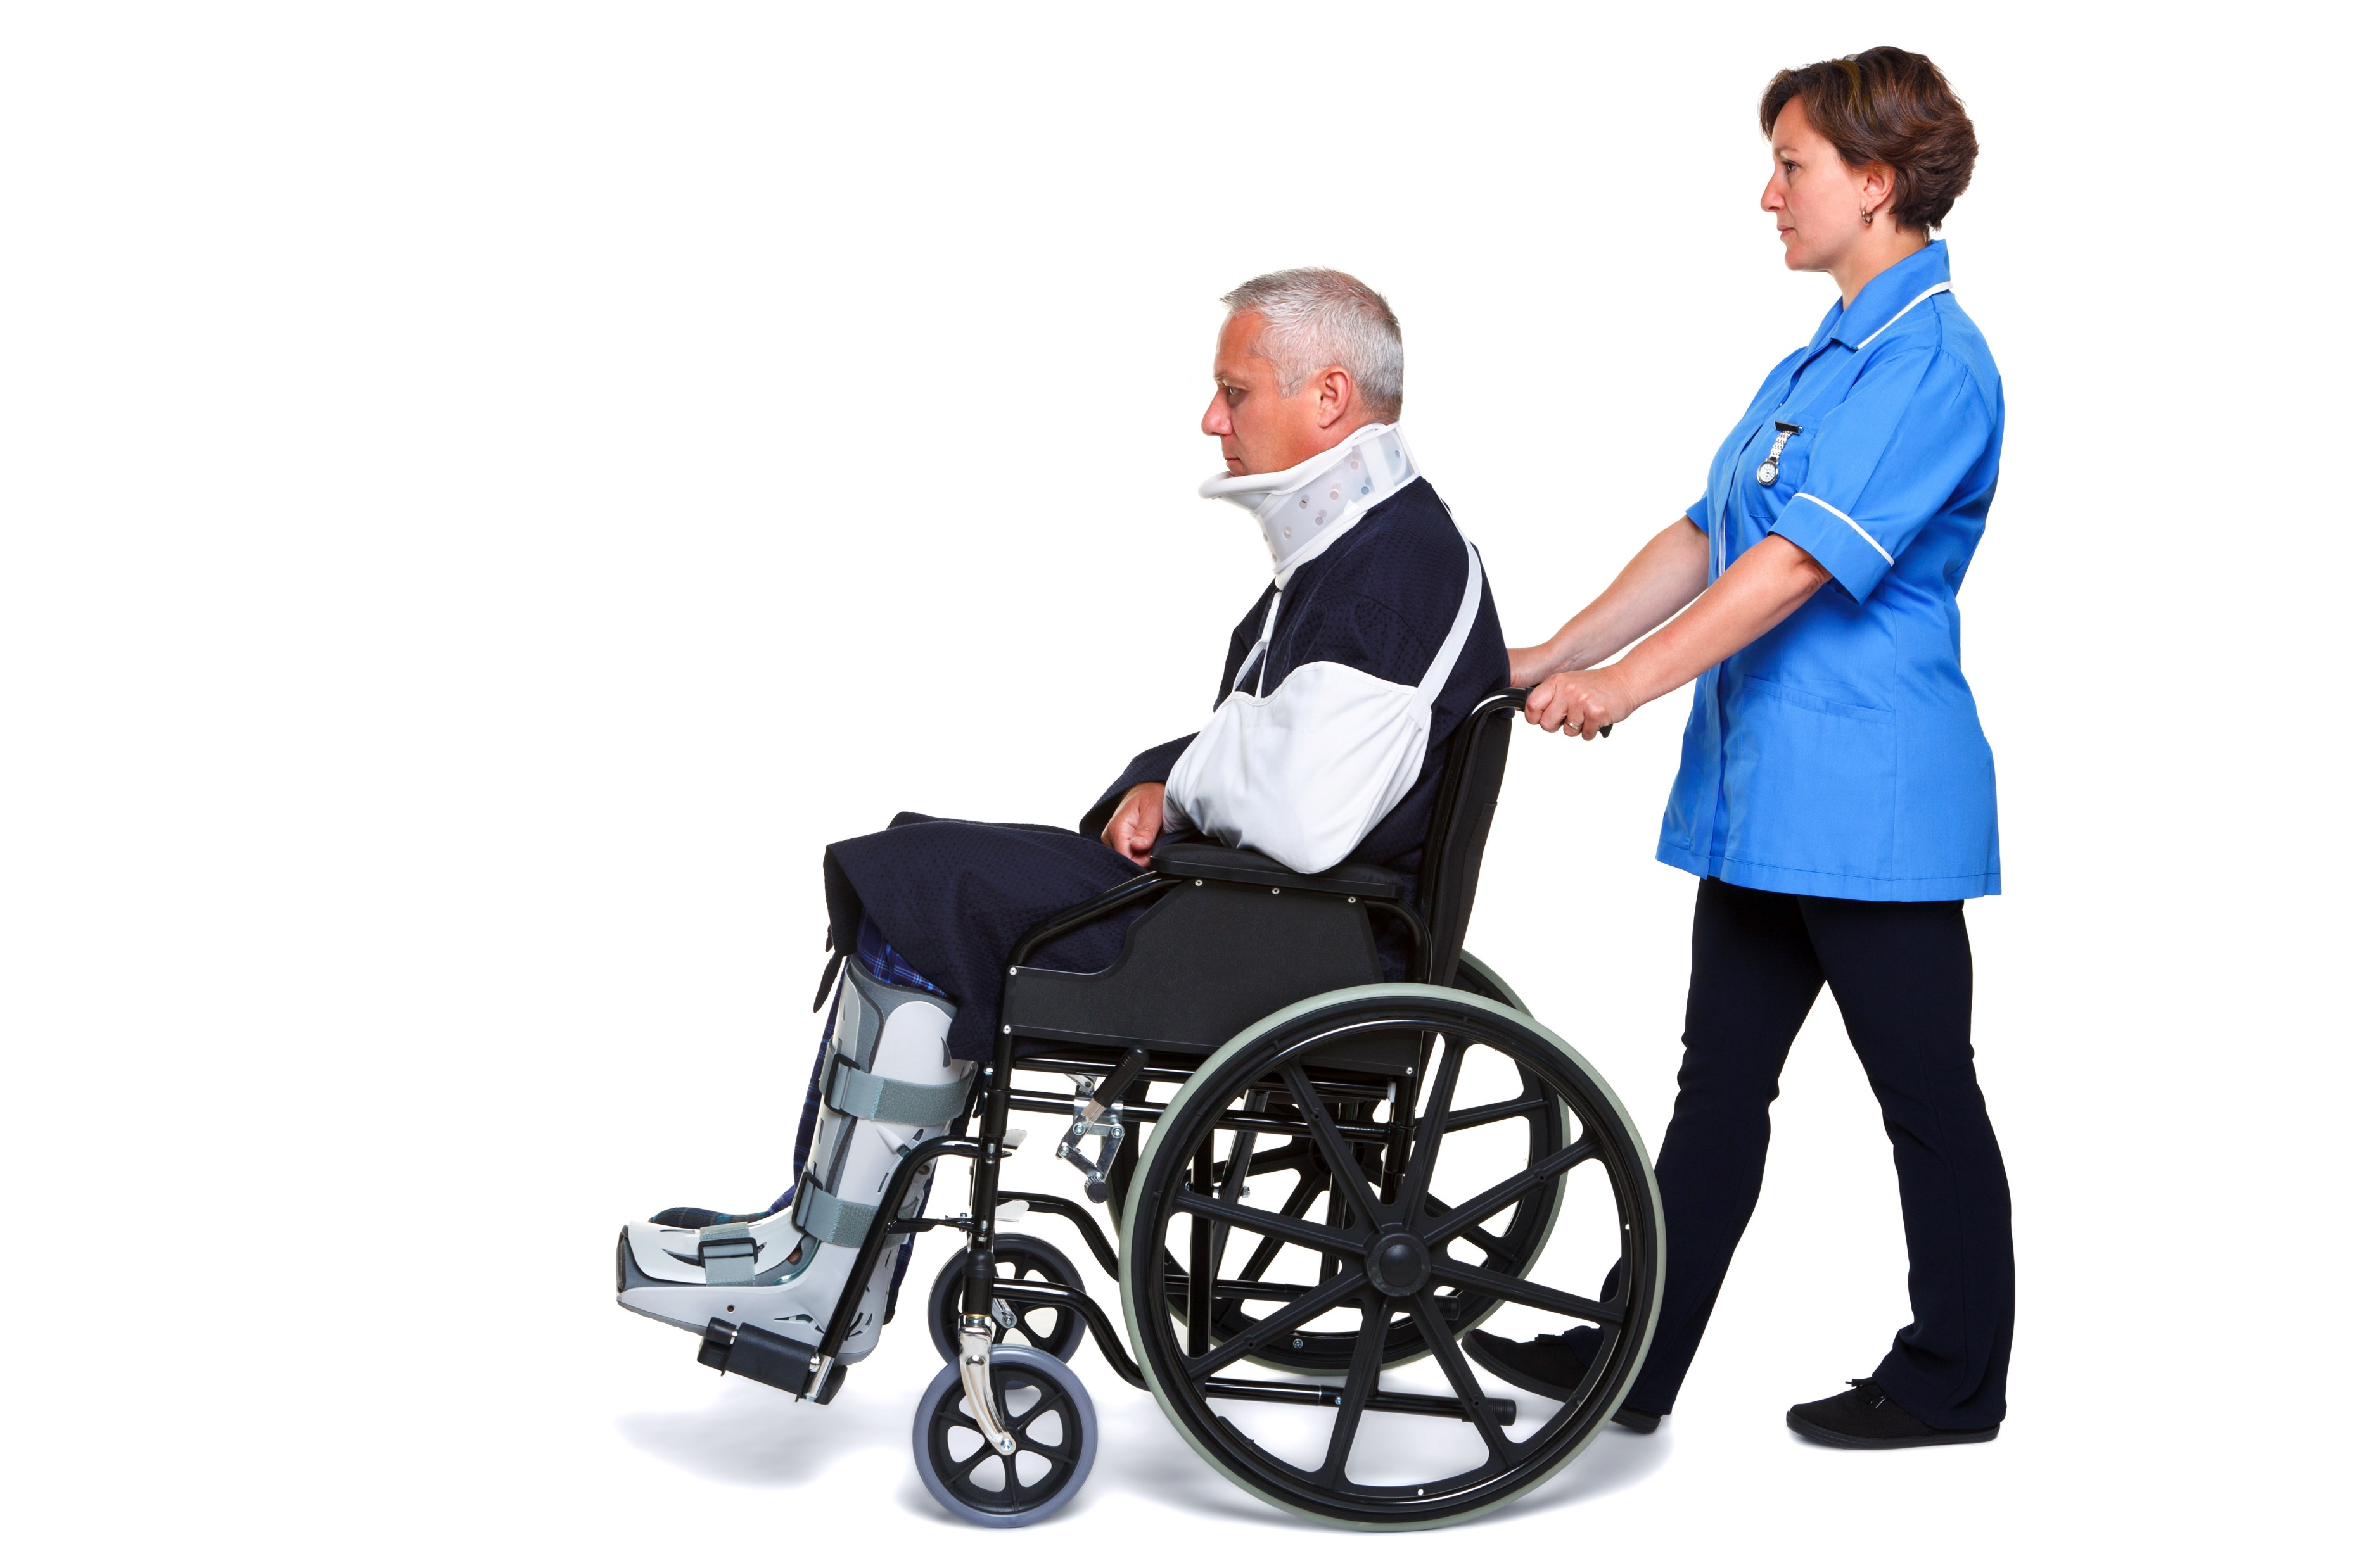
Specialist agencies may provide advocacy support to persons with disability:
With a specific type of disability
With specific issues such as housing, education or employment
From diverse cultural and linguistic backgrounds, including Aboriginal and Torres Strait Island backgrounds
Facilitate Choice And Self-Determination

Slide 121
Older persons have access to advocacy services through the National Aged Care Advocacy Program (NACAP).
The program aims to support older persons so that they:
Can effectively interact with the aged care system
Better transition between aged care services
Are enabled and empowered to make informed decisions about the care they receive
Facilitate Choice And Self-Determination

Slide 122
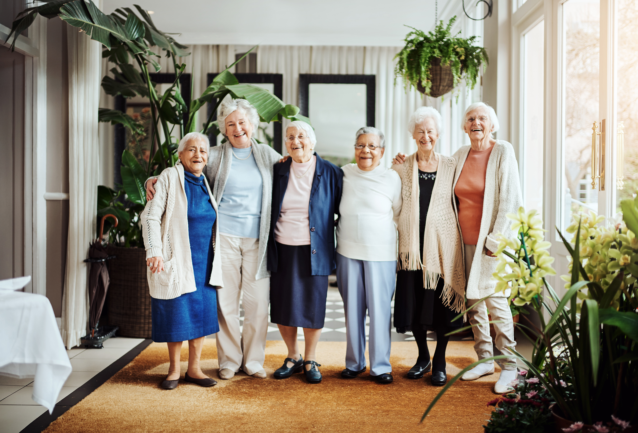
The program aims to support older persons so that they:
Can exercise their right to choose in accessing and receiving aged care services
Have their aged care rights better understood, recognised and upheld
Have their aged care needs better met
Increase their capacity to self-advocate
Facilitate Choice And Self-Determination

Slide 123
The program aims to support older persons so that they:
Can resolve problems or complaints with aged care providers in relation to the aged care services they receive
Know their care rights and responsibilities
Are not subjected to elder abuse within the aged care system
Can address issues that impact their ability to live in their own homes, with the aim of preventing premature admission to aged care facilities and focusing on wellness and reablement.
Facilitate Choice And Self-Determination

Slide 124
As a care worker, you must guide the client in finding and choosing an appropriate agency or support service including:
Looking for specialist agencies that provide support to clients that share the same type experiences as the client including:
Disability
Age
Cultural background
Facilitate Choice and Self-Determination

Slide 125
Looking for specialist agencies that provide support to clients that share the same type experiences as the client including:
Linguistic background
Financial background
Facilitate Choice and Self-Determination

Slide 126
As a care worker, you must guide the client in finding and choosing an appropriate agency or support service including:
Searching for additional information about these agencies
Taking note of significant information that the client may want to know about the agency
Presenting the list of agencies to the client and assisting them in making a choice
Searching for generalist agencies if no specialist agency is available near the client or if the client prefers one
Facilitate Choice and Self-Determination

Slide 127
Clients may also wish to receive help in submitting complaints due to barriers that they face as they try to take part as members of the community.
This happens when a client feels and believe that they were discriminated against or taken advantage of.
In such cases, a care worker must assist the client in submitting their complaints to the Australian Human Rights Commission.
Facilitate Choice and Self-Determination

Slide 128
As you go through the complaint process, keep the following in mind:
The commission will only investigate complaints that are related to human rights violations. To confirm if a complaint is valid, you may either:
Call the commission’s National Information Service at 1300 656 419
Send an email to infoservice@humanrights.gov.au
Facilitate Choice and Self-Determination

Slide 129

As you go through the complaint process, keep the following in mind:
The commission may stop investigating the complaint for various reasons.
Usually, they will contact the person to explain why they cannot do further investigation.
Foster Human Rights

Slide 130
As a care worker, for that reason, you must:
Discuss this with the person before submitting the complaint to set proper expectations
Prepare the person to escalate the complaint to the federal circuit court, if necessary
Facilitate Choice and Self-Determination

Slide 131

What have we learnt?
In this part of the session, we have covered:
Demonstrate commitment to empowerment for people receiving support
Foster human rights
Facilitate choice and self-determination

Slide 132
End of Chapter 3

Slide 133

Presentation Objectives
Now that you have completed this presentation, you should be able to:
Demonstrate commitment to empowerment for people receiving support
Foster human rights
Facilitate choice and self-determination

Slide 134
End of CHCCCS038 Presentation

Slide 135
Version Control & Document History
Date | Summary of Modifications | Version
23 December 2022 | Version 1.0 released for publishing | 1.0
14 April 2023 | Version 1.1 endorsed for use Minor revisions for improved readability | 1.1
22 August 2023 | Version 1.2 endorsed for use Fixed wording issues | 1.2

